Slide 1


Convolutional Autoencoder with gamma correction module (GAE) for automatic image colorization
course: Computer Vision 2023/24
student: Angelo Gianfelice 1851260
PROJECT PRESENTATION
Notes:
‹#›

Slide 2
Outline:
Introduction
Related Works
Proposed methods
Datasets and Metrics
Implementation details
Experimental results
Conclusion and Future Works

Slide 3
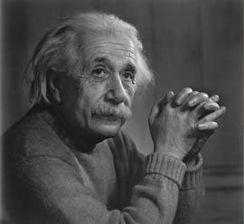
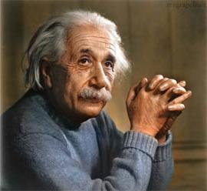
Deep Learning Image Colorization
Deep Learning
network
Improving many computer vision tasks by augmenting feature extraction, contrast, and interpretability.
Historical and cultural restoration
Enhancing medical imaging
Object Detection & Scene Understanding
(and much more …)

Slide 4
Related Works
Early Approaches
Levin et al. (2004): Scribble-based optimization
Irony et al. (2005): Image retrieval for color transfer
CNN-Based Methods
Zhang et al. (2016): End-to-end CNN with classification loss
Iizuka et al. (2016): Global-local context model
GAN-Based Colorization
Nazeri et al. (2018): Adversarial learning for vibrant colors
Cao et al. (2017): User-guided GAN for interactive colorization
Transformer & Diffusion Models
Kumar et al. (2021): Colorization Transformer
Liu et al. (2023): Diffusion models for semantic colorization

Slide 5

Proposed Architecture (GAE)
input grayscale image
GAE
output colorized image
RGB to LAB
Autoencoder
Gamma correction
LAB to RGB
L*
ab*
lab

Slide 6
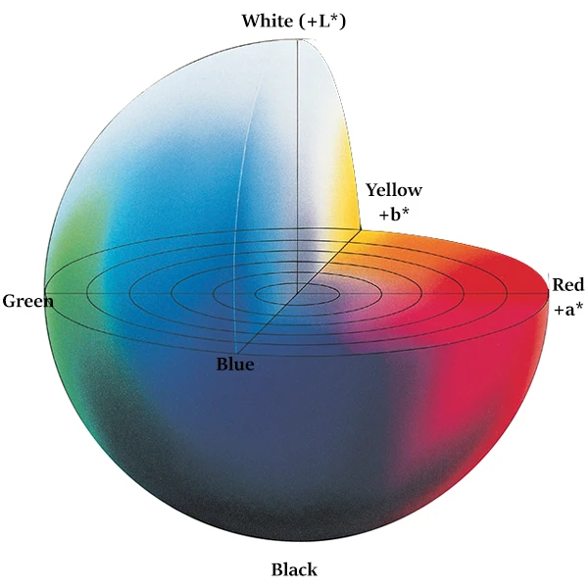
LAB Color Space
designed to match human vision closer than rgb
LAB color has 3 components:
L* → Lightness (0 = black, 100 = white)
A* → Green–Red axis (-128 = green, 127 = red)
B* → Blue–Yellow axis (-128 = blue, 127 = yellow)
color information stored in only 2 channels(ab)
widely used in colorization tasks

Slide 7
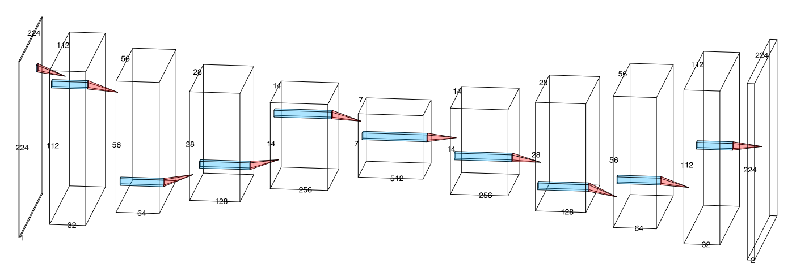
Autoencoder architecture
symmetric 10-layer convolutional autoencoder
batch normalization after every encoder layer
upsampling through deconvolution in decoder
Tanh final activation function to predict a*b* channels (normalized in [-1,1])

Slide 8
Gamma Correction
empirically I noticed that colorized images often are very dull and unsaturated, as the model does very conservative predictions in order to minimize loss
𝑋out = 𝑋in
non linear operator to enhance colorization, augmenting saturation and contrast
learnable 𝛾 (initialized to 1)
𝛾

Slide 9
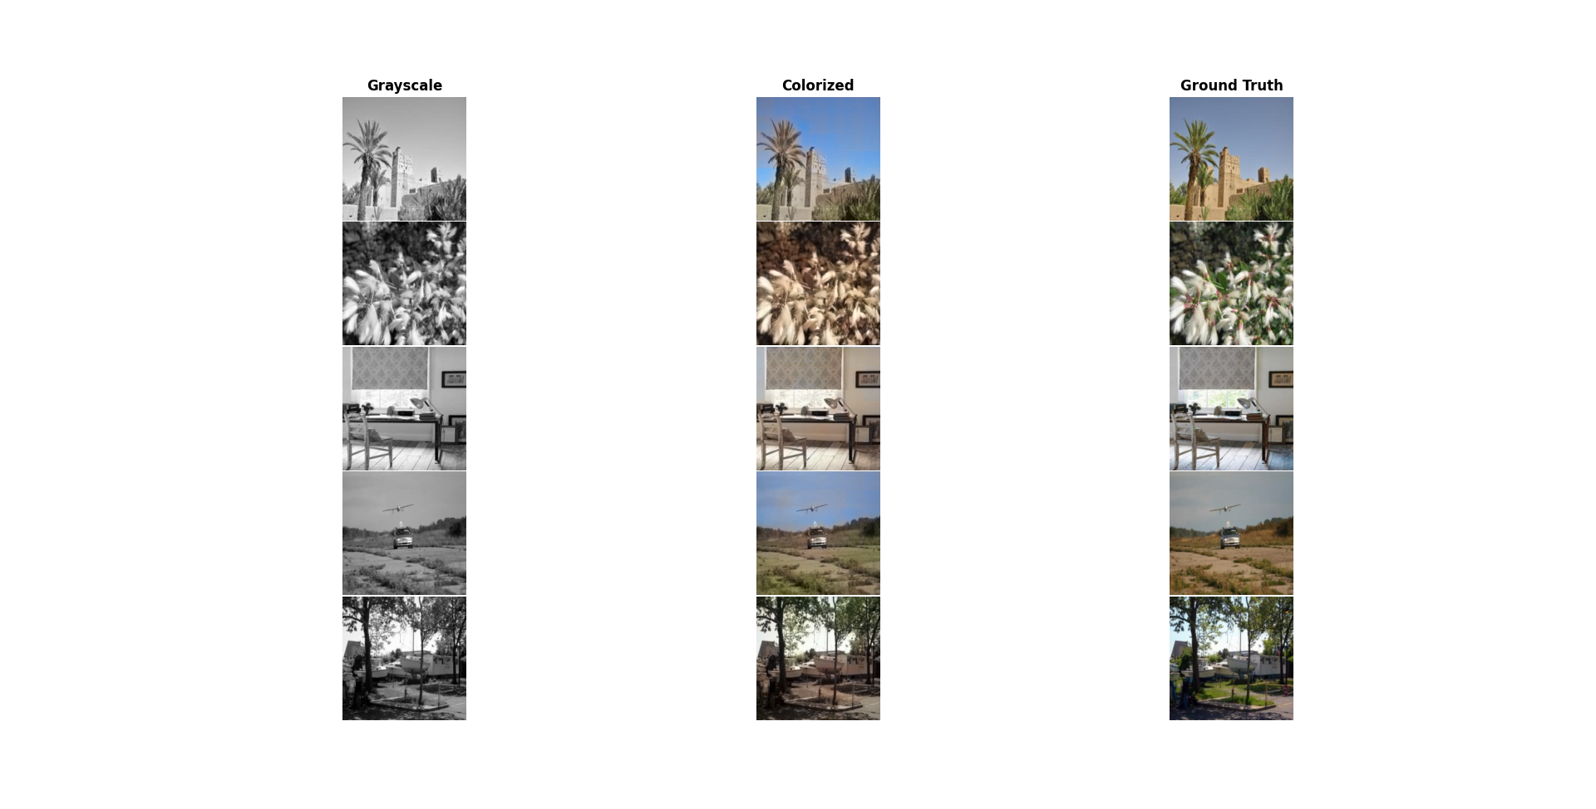
Baseline
Resnet-18 model as a fixed feature extractor
Feature fed directly to decoder-only architecture
faster training, but worst results as only the decoder part is trained for the colorization task
input RGB image
output RGB image
Resnet-18
Decoder

Slide 10
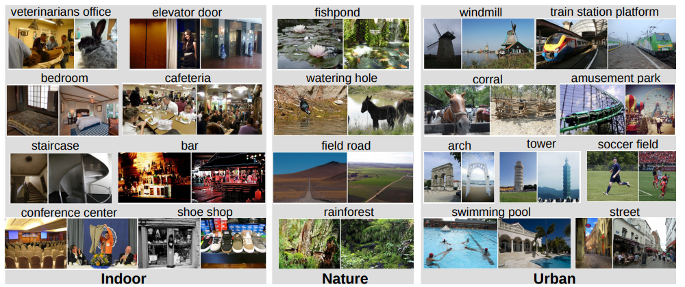
Dataset
small subset of the Places dataset, which contains 10 million images from diverse environments, from natural landscapes to urban settings.
30K image dataset divided in a 70-15-15 split
resized images to 224x224
data augmentation: random rotation, flipping and cropping

Slide 11
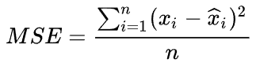
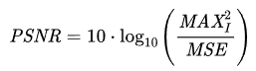
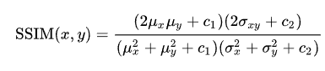
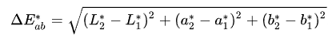
Evaluation Metrics
pixel-wise metrics:
MSE: average squared difference between corresponding pixels.
PSNR (Peak Signal-to-Noise Ratio): Measures image quality in decibels (dB)
perceptual metrics:
SSIM: measures luminance, contrast, and structure similarity.
ΔE(76): measures perceptual color difference

Slide 12
Results: Baseline Comparison
model tested on test set (4500 images) and compared with baseline
 | MSE ↓ | PSNR ↑ | SSIM ↑ | ΔE ↓
baseline | 0.0063 | 23.7471 | 0.9189 | 13.9822
GAE | 0.0057 | 24.5263 | 0.9408 | 12.9247
The proposed architecture outperforms the baseline in every metric by a substantial margin

Slide 13
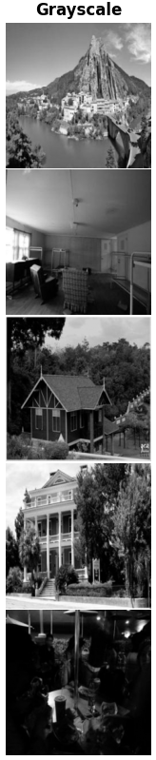
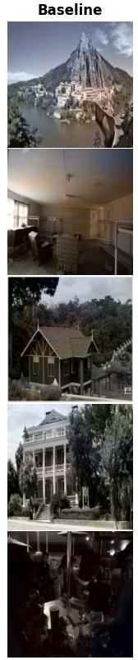
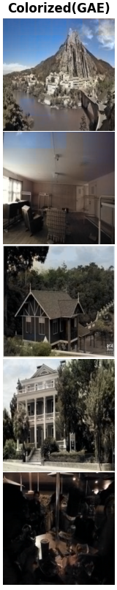
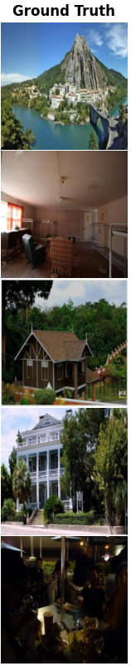
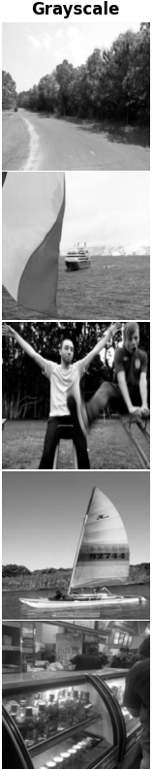
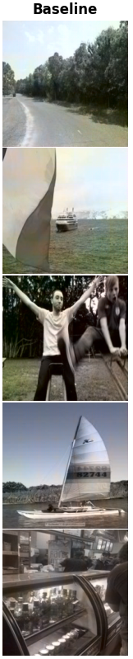
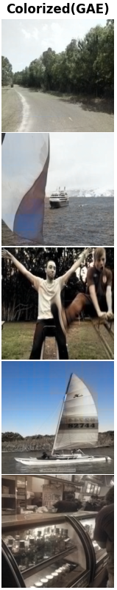
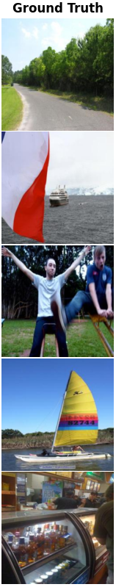
Results: Colorized Images

Slide 14
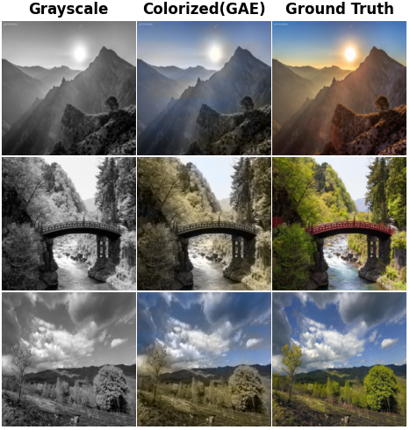
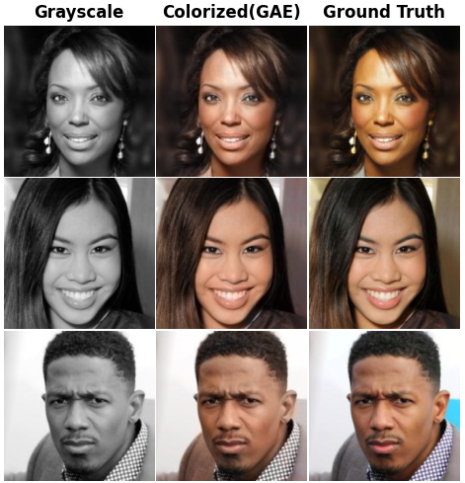
Results: Different Experiments
model trained on more than 4000 nature/landscapes images
model trained on a 5k subset of the CelebA dataset

Slide 15
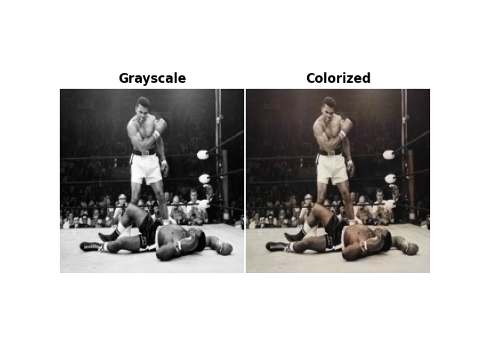
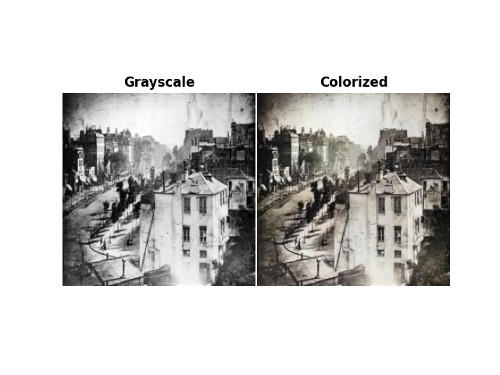
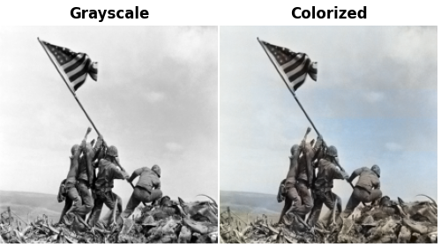
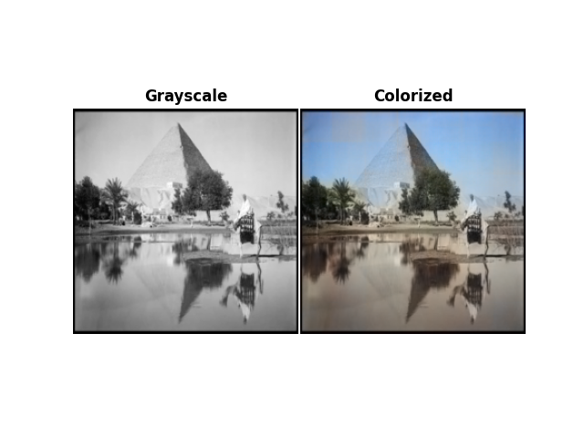
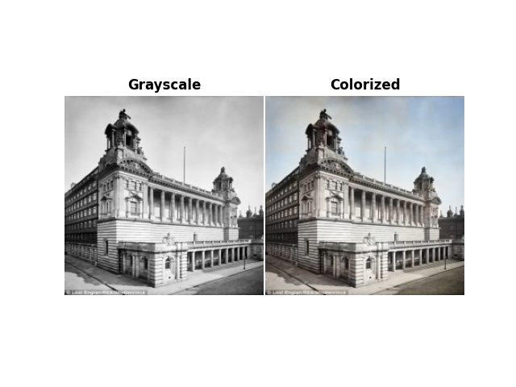
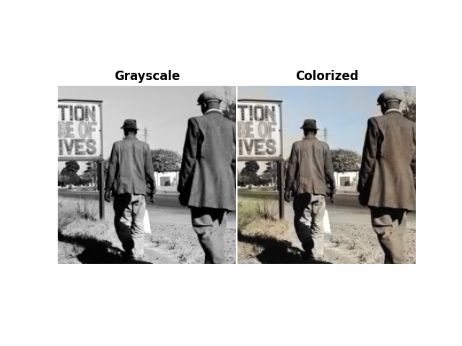
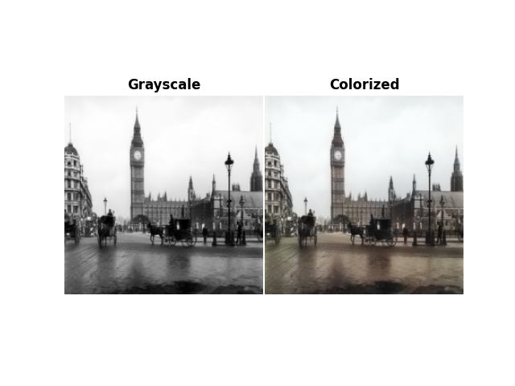
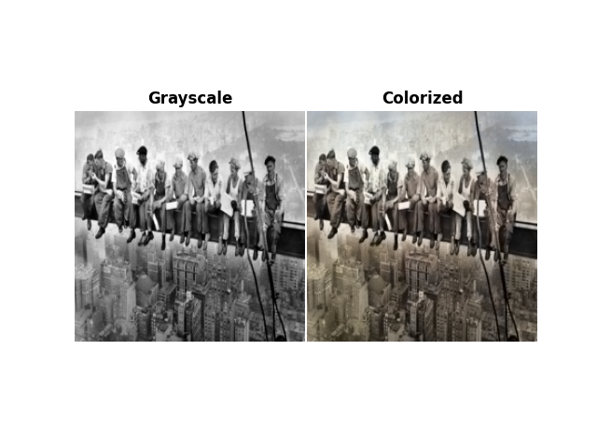
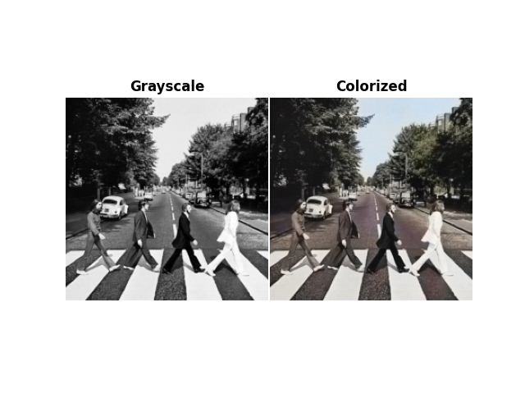
Historical photograph colorization
since there exists no ground truth, the results are very hard to judge, but promising

Slide 16
Conclusions and future works
Even though results cannot be comparable to the state of the art, my model is successfully able to colorize images in a natural and vibrant way, while being relatively lightweight. Future improvement might include:
Increasing number of images in training data for better generalization
Use perceptual loss for more realistic colors
Finetune model on different datasets for different application
Extend model in order to colorize videos

Slide 17
THANKS FOR THE ATTENTION!!

Slide 18
References
Places: A 10 million Image Database for Scene Recognition B. Zhou, A. Lapedriza, A. Khosla, A. Oliva, and A. Torralba. IEEE Transactions on Pattern Analysis and Machine Intelligence, 2017
Levin A., Lischinski D., Weiss Y. (2004). Colorization using optimization. In ACM SIGGRAPH 2004 Papers (pp. 689–694).
Irony, R., Cohen-Or, D., & Lischinski, D. (2005). Colorization by example. Proceedings of the 16th Eurographics Conference on Rendering Techniques, 201–210. https://www.cs.tau.ac.il/~dcor/online_papers/papers/colorization05.pdf
Zhang, R., Isola, P., & Efros, A. A. (2016). Colorful image colorization. European Conference on Computer Vision (ECCV), 649–666. https://doi.org/10.1007/978-3-319-46487-9_40
Iizuka, S., Simo-Serra, E., & Ishikawa, H. (2016). Let there be color! Joint end-to-end learning of global and local image priors for automatic image colorization with simultaneous classification. ACM Transactions on Graphics (TOG), 35(4), 1–11. https://doi.org/10.1145/2897824.2925974
Nazeri, K., Ng, E., & Ebrahimi, M. (2018). Image colorization using generative adversarial networks. arXiv preprint arXiv:1803.05400. https://arxiv.org/abs/1803.05400
Cao, Y., Zhang, Z., Dong, J., & Liu, T. (2017). User-guided deep neural network for interactive image colorization. arXiv preprint arXiv:1707.05584. https://arxiv.org/abs/1707.05584
Kumar, M., Weissenborn, D., & Kalchbrenner, N. (2021). Colorization transformer. International Conference on Learning Representations (ICLR). https://arxiv.org/abs/2102.04432
Liu, H., Xing, J., Xie, M., Li, C., & Wong, T.-T. (2023). Improved diffusion-based image colorization via piggybacked models. arXiv preprint arXiv:2304.11105. https://arxiv.org/abs/2304.11105

